Slide 1
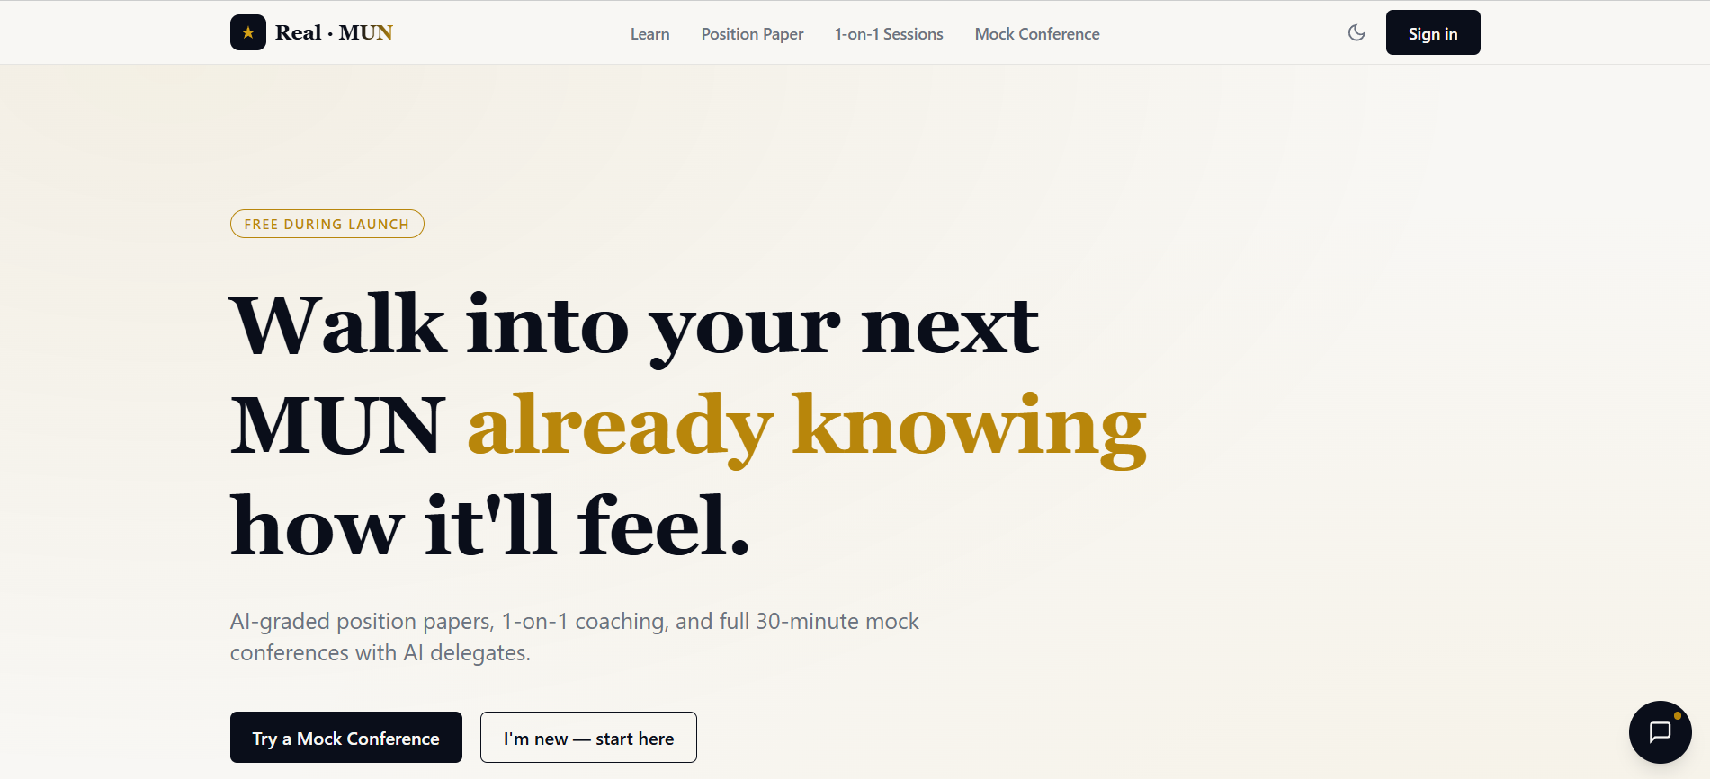
REAL · MUN
Walk into your next MUN already knowing how it'll feel.
INSERT PHOTO (landscape)
Real-MUN homepage
Built by Ayaan Dhuria · 9th Grade · 2 years of Model UN · Best Delegate & Honorable Mention
YOUTH CODE × AI HACKATHON 2026

Slide 2
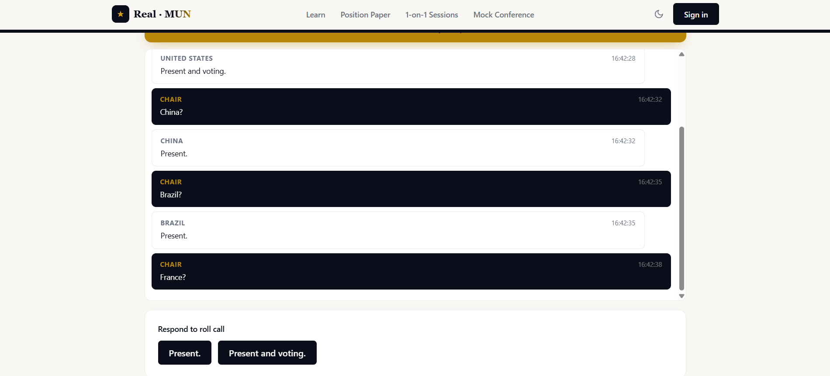
Most delegates walk in unprepared — and it's not their fault.
INSERT PHOTO (landscape)
a real MUN committee in session
(delegates at a conference)
No realistic practice
There's no way to rehearse a committee before the real thing.
Feedback comes too late
Dais feedback only arrives after the conference is already over.
Coaching is a privilege
Good MUN coaching is expensive and locked behind elite schools.
“It was my third conference, and I looked around at delegates sitting in complete silence — not because they had nothing to say, but because no one had ever shown them how. It took me right back to my own first committee, when I was the quiet one too. That's when I knew I could build something to help people understand Model UN before they ever walk into the room.”

Slide 3
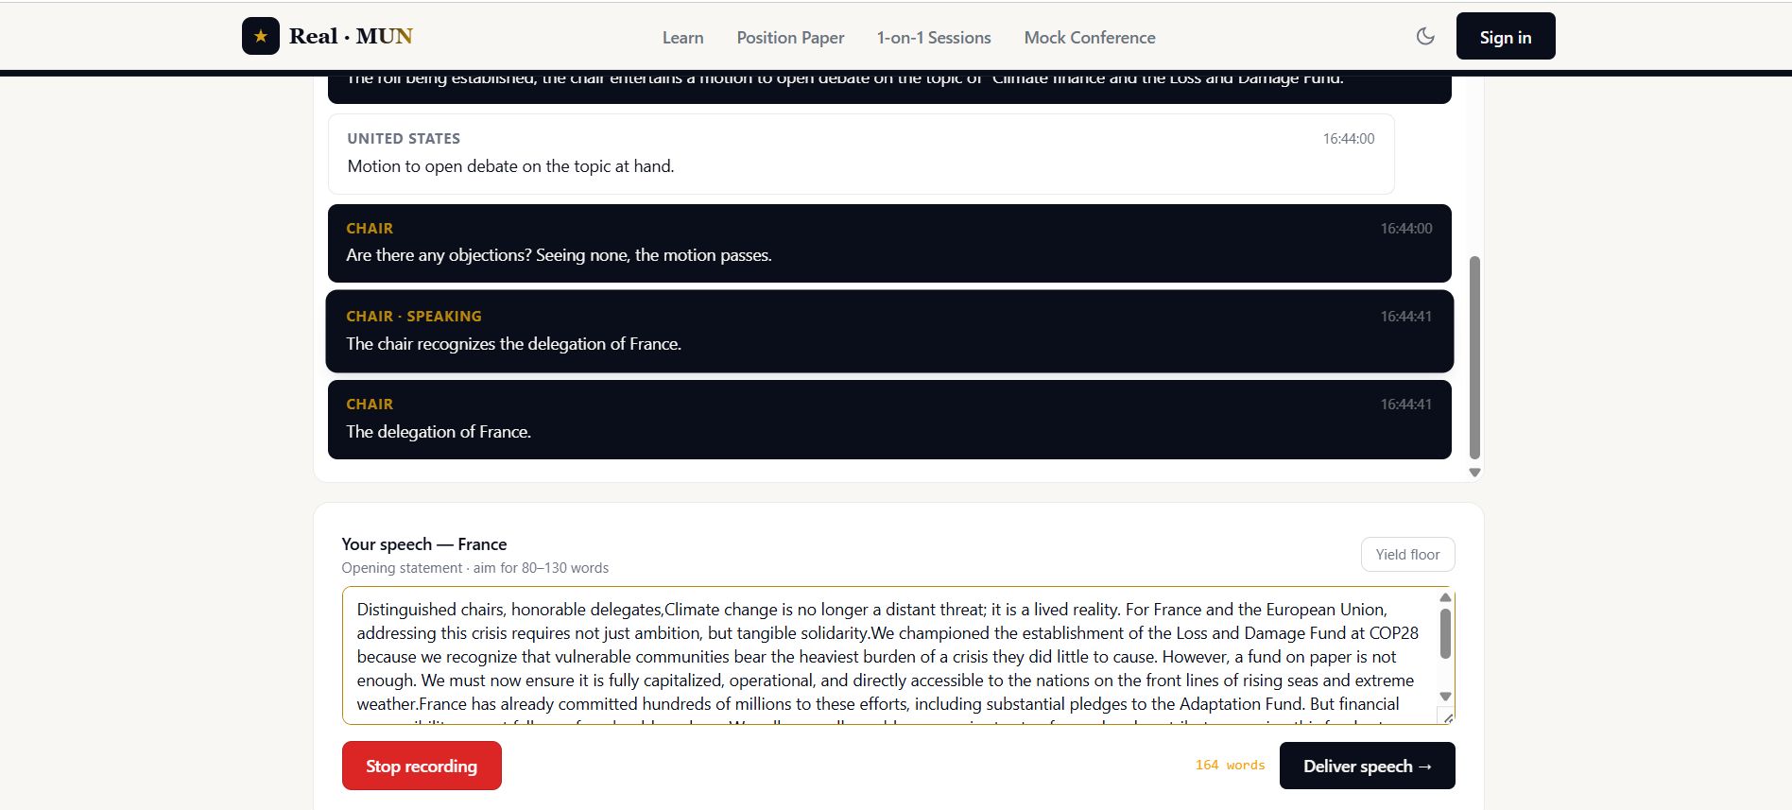
THE SOLUTION
Real-MUN lets you rehearse the whole experience — with AI.
INSERT PHOTO (landscape)
Ayaan delivering a speech
at a real conference
A free platform where any student can practice unlimited mock committees and get instant, expert-level feedback — as many times as they need.

Slide 4
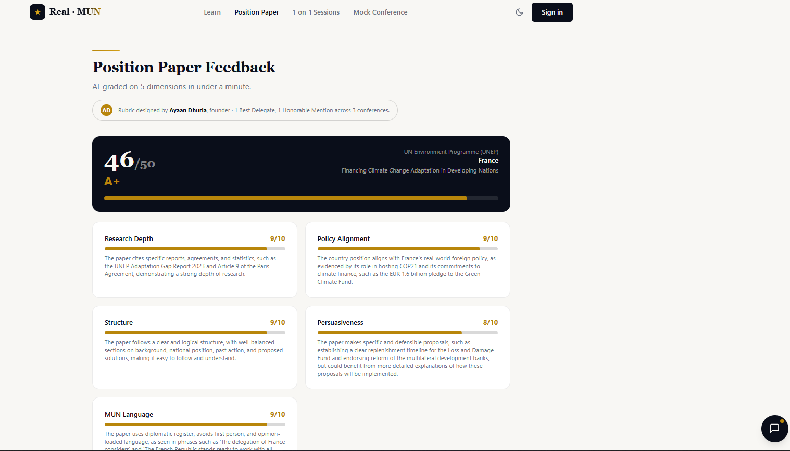
WHAT IT DOES
Everything you need to be ready.
Mock Conference
A full 30-minute committee with an AI Chair and three AI delegates you speak to out loud.
Position Paper Feedback
AI scores your paper across five dimensions in under 60 seconds.
INSERT PHOTO (landscape)
position paper grading
in Real-MUN (screenshot)
Speech & Session Feedback
Judged like a real Dais — with specific, line-by-line rewrites.
Learn the Basics
Procedure, vocabulary, and fundamentals for first-timers.

Slide 5
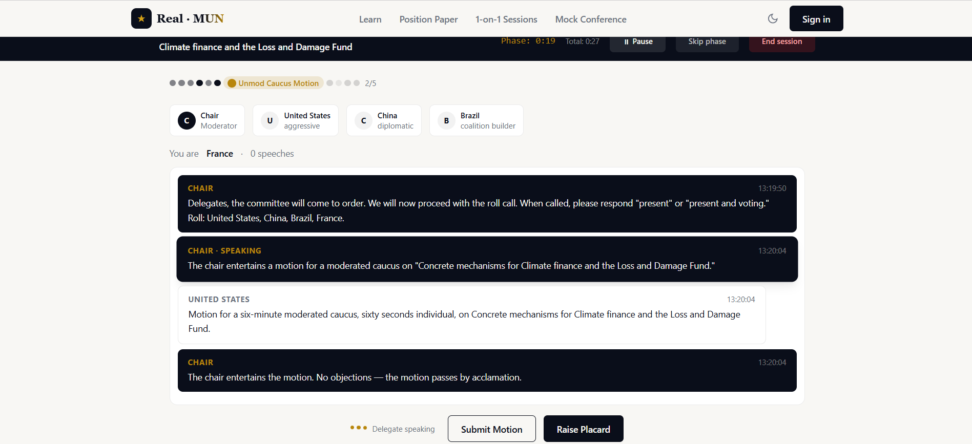
See it in action.
real-mun.vercel.app
A full mock committee — live.
INSERT PHOTO (landscape)
Real-MUN live mock conference
(AI Chair + delegates mid-debate)

Slide 6
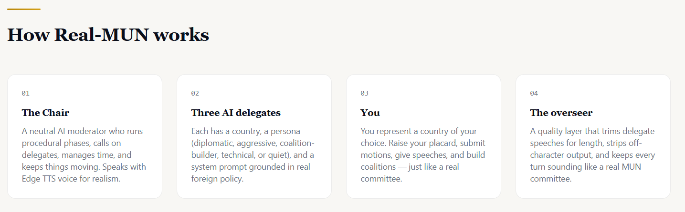
HOW IT WORKS
Real procedure. Real foreign policy. Real feedback.
INSERT PHOTO (landscape)
Real-MUN conference screen
(or your code in the editor)
Deterministic procedure engine
Authentic MUN parliamentary flow runs the same way every session.
Country-accurate AI delegates
Each delegate argues from its nation's real foreign policy and persona.
Full voice interface
Speak your speech out loud — and hear the whole committee respond.
Built with Next.js · React · TypeScript · large-language models with automatic multi-provider failover · deployed on Vercel.

Slide 7
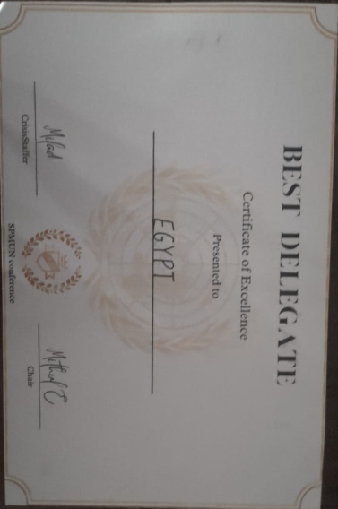
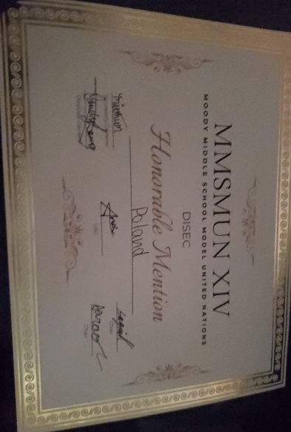
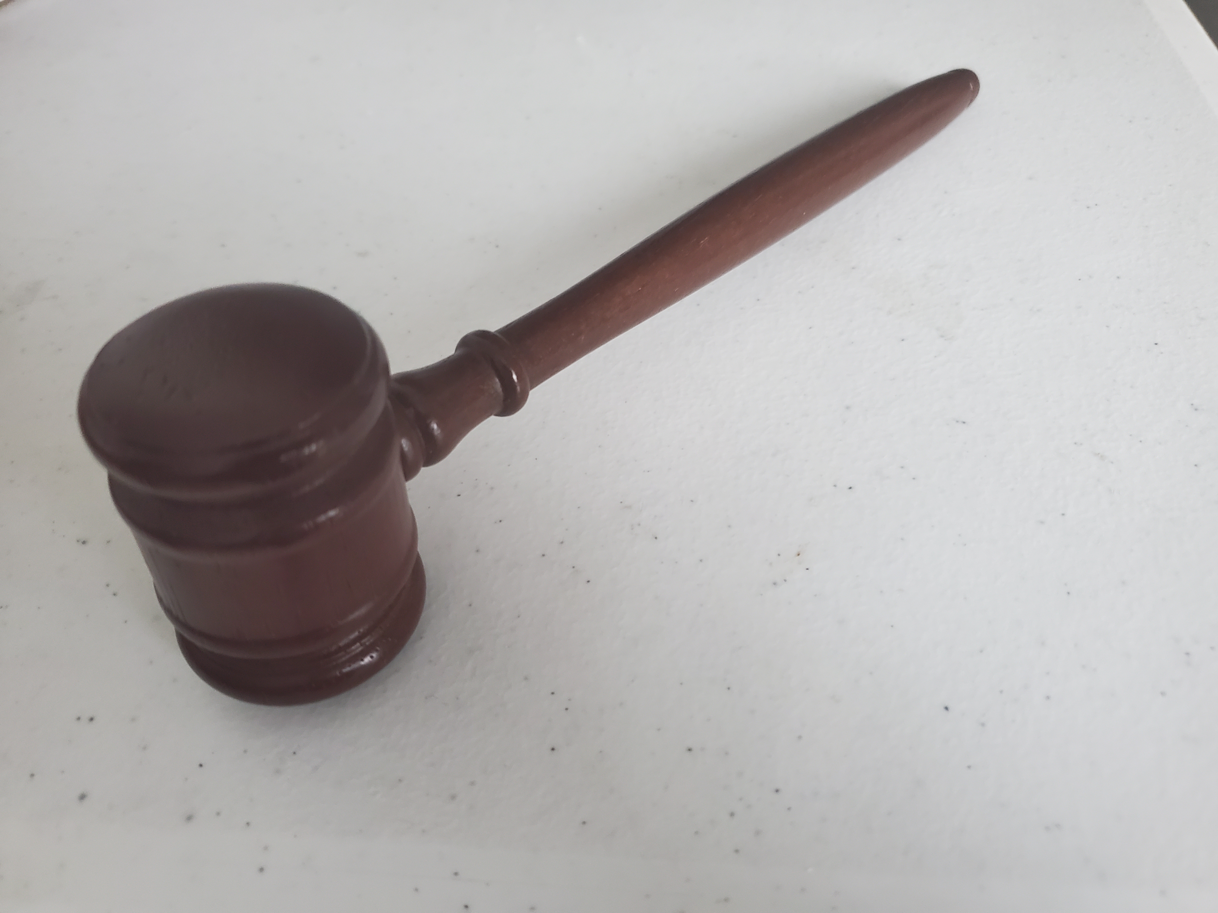

IMPACT
Practice shouldn't be a privilege.
$0
10+
Cost to students
Free and unlimited — no barrier.
Delegates already tested it
Validated by real MUN participants.
For students at schools with no MUN program, no coach, and no budget.

Slide 8
INSERT PHOTO (landscape)
Real-MUN homepage
Walk in ready.
Real-MUN — by Ayaan Dhuria
Thank you for listening.
real-mun.vercel.app

